Slide 1
Symbolism
&
Nabis
History of Modern Art
BFA-III (Visual Arts)
Course Incharge: Ms. Sidra Liaqat
Institute of Design & Visual Arts, LCWU

Slide 2
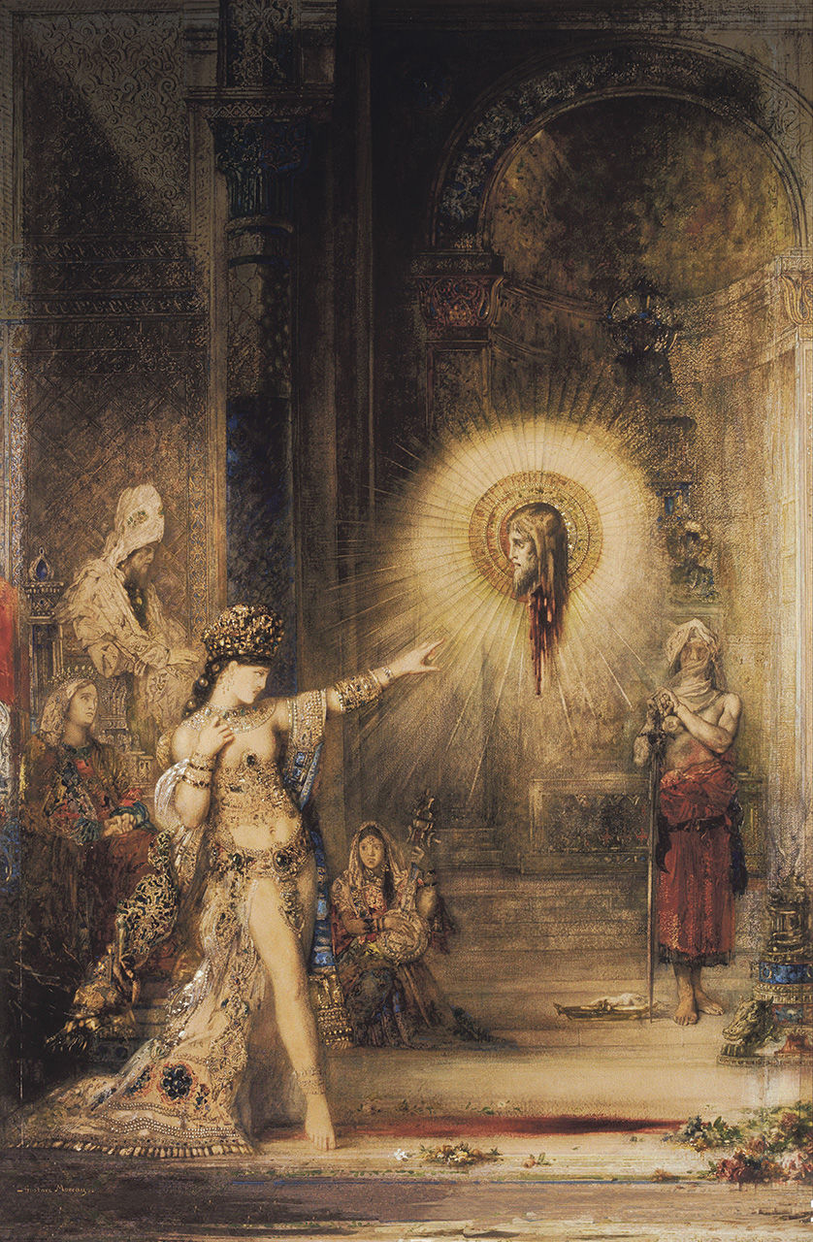
GUSTAVE MOREAU
“The Apparition”
(1876)

Slide 3
EDVARD MUNCH
“The Scream” (1893)

Slide 4
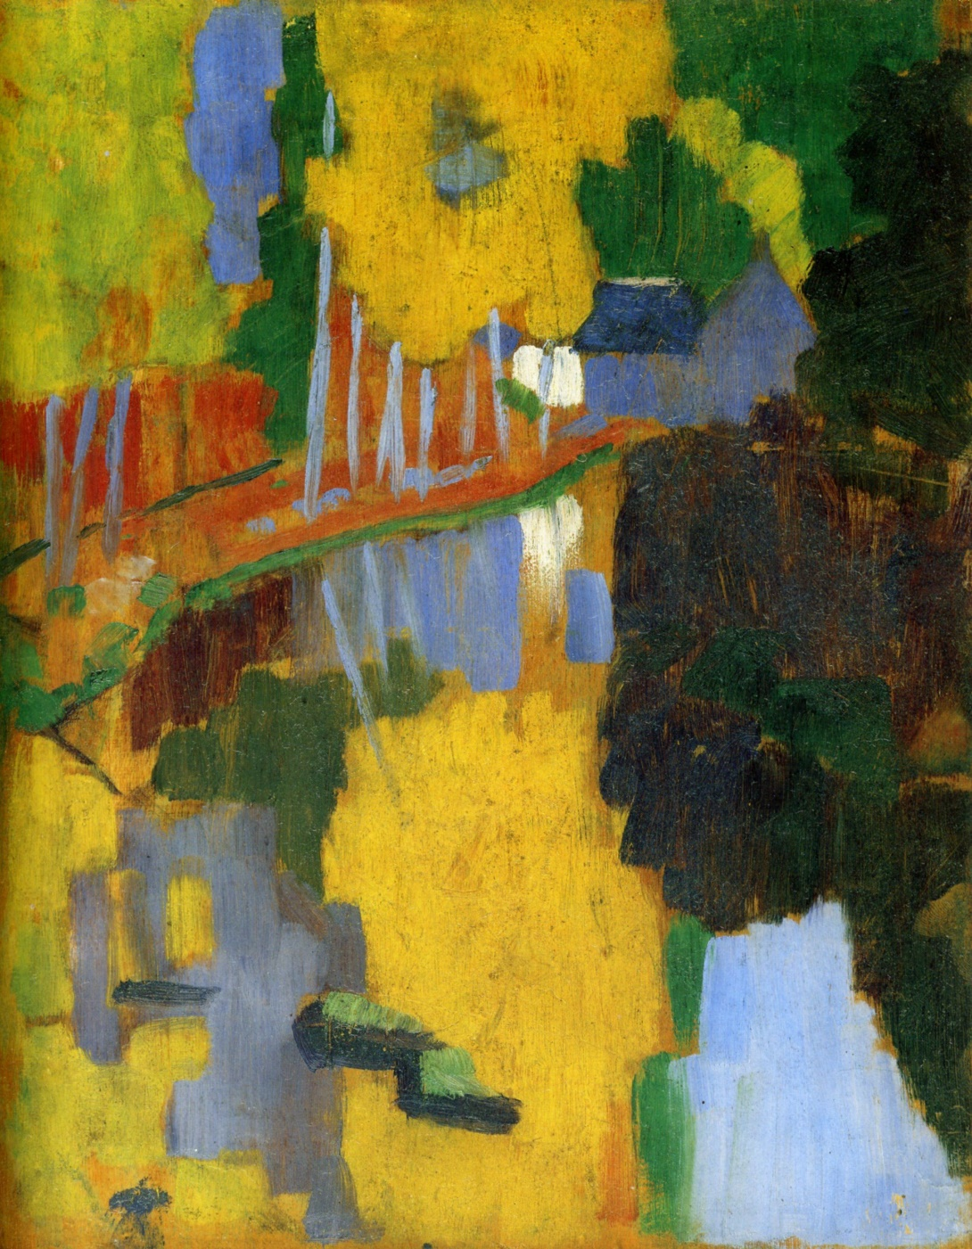
PAUL SÉRUSIER
“Landscape at the Bois d’Amour at Pont-Aven” / “The Talisman” (1888)

Slide 5
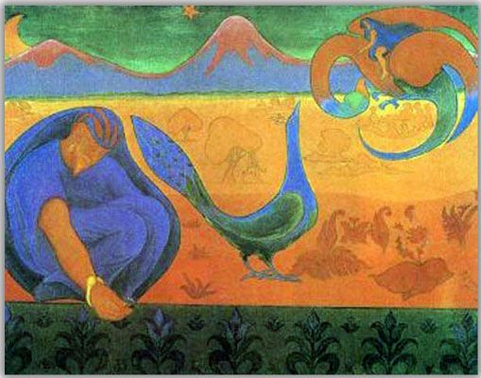
PAUL RANSON
“Nabi Landscape” (1890)

